Slide 1

Introduction to ORMs
Chris Cumming Saturday Morning Productions October 11th, 2018
NAIT Digital Media and IT Students Association.

Slide 2
Demos
Demo Location:
https://github.com/saturdaymp/IntroductionToOrmsPresentation
Prerequisites:
Visual Studio 2017 (free community version for Windows or Mac): https://www.visualstudio.com/
.NET Core 2.1 https://www.microsoft.com/net/download
Docker (free community version): https://www.docker.com/docker-community

Slide 3


Shameless Self Promotion
Saturday Morning Productions - Consultant
http://nftb.saturdaymp.com
@saturdaymp
chris.cumming@satudaymp.com
Edmonton .NET Users Group - Program Director
http://edmug.net
info@edmug.net

Slide 4
What is Object-Relational Mapping (ORM)?
Wikipedia Definition
Object-relational mapping (ORM, O/RM, and O/R mapping tool) in computer science is a programming technique for converting data between incompatible type systems using object-oriented programming languages. This creates, in effect, a "virtual object database" that can be used from within the programming language. There are both free and commercial packages available that perform object-relational mapping, although some programmers opt to construct their own ORM tools.
My Definition
Map relational data to objects.

Slide 5
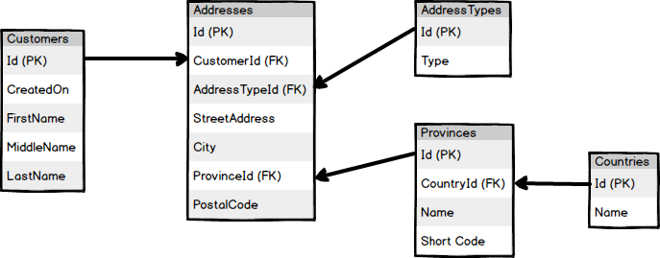
Tables and Fields Look Like Classes and Properties

Slide 6
Popular ORM Frameworks
Hibernate – Java, repository, open source
http://hibernate.org/orm/
Nhibernate – C# version of Hibernate
http://nhibernate.info/
Active Record – Ruby on Rails, active record
https://guides.rubyonrails.org/active_record_basics.html
Entity Framework – Microsoft, repository
https://docs.microsoft.com/en-us/ef/

Slide 7
Active Record vs Repository
Active Record: The model knows how the save it’s self.
var customer = new Customer();
customer.Name = ‘John’;
customer.Save();
Repository: The model does not know how save it’s self.
var customer = new Customer();
customer.Name = ‘John’;
var repo = new CustomerRepo();
repo.SaveCustomer(customer);

Slide 8
Code First vs. Database First
Code First: Create the database from the models in the code.
Database First: Create the models from the database.

Slide 9
Migrations
File(s) and/or script(s) to update database schema.
Can also be used to update data.
Migrations can be manually created or auto-magically generated.
Usually run migrations when the software is released.

Slide 10
Database Context
Connection to the database from the code.
Typical pattern:
Create context and connect to database
Do work (e.g. query, save, etc)
Close context
Sometimes called the Unit of Work pattern

Slide 11
Lazy vs Eager Loading
Lazy loading loads the data when needed.
var customer = repo.FindCustomer(42);
Console.WriteLine(customer.Addresses.Frist().Name); // Address is loaded here.
Eager Loading loads all the data in the query.
var customer = repo.FindCustomer(42); // Address is loaded here.
Console.WriteLine(customer.Addresses.Frist().Name);
Most of the time you want eager loading.

Slide 12
DTOs and Auto-Mappers
DTO: Data transformation object.
Auto-Mappers copy data from one object to another.
Often used when you need to map data from a database or service to your view objects.

Slide 13
Problems with ORMs
Inefficient queries and/or too many queries.
Bringing back unneeded data and/or columns.
Not good for complicated queries and reports.
Fixes:
Profile the queries.
Use eager loading and avoid multiple DB requests.
Write queries manually
Don’t be afraid to ask DBA for help.

Slide 14
Learning More
Slides and Example Code:
https://github.com/saturdaymp/IntroductionToOrmsPresentation
Introduction to ORMs for DBAs:
https://github.com/saturdaymp/IntroductionToORMForDBAs https://nftb.saturdaymp.com/category/software-development/introduction-to-orms-for-dbas/
Entity Framework Core:
https://docs.microsoft.com/en-us/ef/core/
Rails Active Record:
https://guides.rubyonrails.org/active_record_basics.html

Slide 15
Contact Me
http://nftb.saturdaymp.com
@saturdaymp
https://github.com/saturdaymp
chris.cumming@satudaymp.com
http://edmug.net
info@edmug.net

